Slide 1
I. The Origins of Roman Civilization

Slide 2
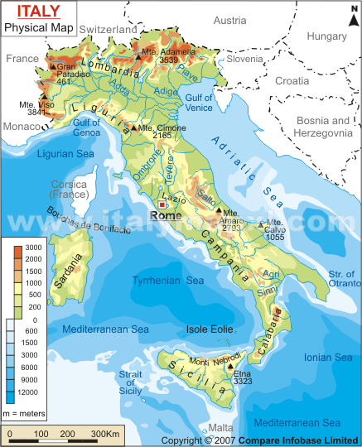
A. Started as a city-state
Rome originally small city on Tiber River
Settled by people called the “Latins”

Slide 3
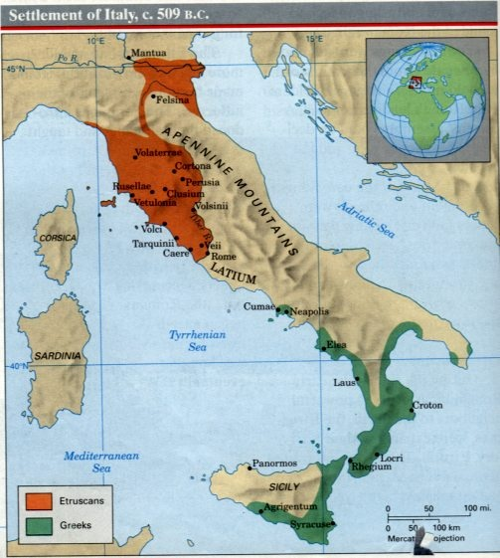
B. Original Neighbors
Northern Italy controlled by Etruscans
They were originally from Anatolia
Latins/Roman learned many things from Etruscans
Architecture, some religious beliefs, alphabet, etc.
Romans overthrew Etruscan rule in 509 BCE and set up a new gov’t called a republic

Slide 4
C. The Republic (509 – 133 BCE)
Republic = Representative gov’t where people vote
Upper classes voted for other upper classes
Patricians!!!!!!!!!!!!!!!!
To be members of the Senate or one of the two Consuls (executives)
Senate and Consuls had to work together!

Slide 5
D. Plebeians want more rights
Plebeians = lower classes (merchants, traders, peasants, laborers, non-slaves)
Demanded written laws so it was fair for everyone
450 BCE = Twelve Tables written
Later demanded representation in Gov’t
Position of Tribune to represent Plebeians
Women too, were eventually given more rights, as men had always been considered their masters and head of the household

Slide 6
II. From Republic to Empire

Slide 7
A. The Punic Wars
B/w Rome and Carthage: 264-146 BCE
Series of 3 wars
Carthage was Phoenician colony in Northern Africa across from Sicily
Rome won all 3 wars, but 2nd one is famous

Slide 8
5. 2nd Punic War: Carthaginian general Hannibal attacks from the North through the Alps
6. Winning this war and other wars helped the rich get richer and more land

Slide 9
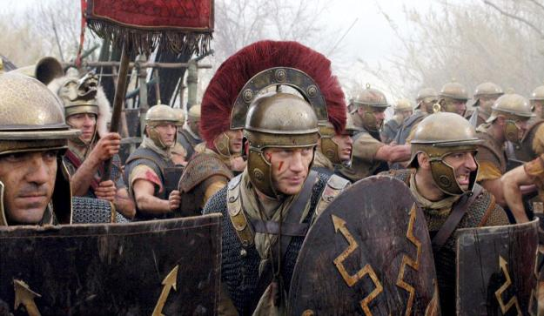
B. Dictatorship over Republic?
Senate became very corrupt
Patricians only wanted to help themselves
Lower classes in army began to put their loyalty to their general over the gov’t/senate
Some wanted generals to take over Rome get rid of the Senate altogether
Military leaders began to challenge one another for power

Slide 10
C. The Republic officially ends
Julius Caesar tried to take power from Senate when he brought his army into Rome…
Became leader of Rome until he was assassinated
His killers were hunted down, his grandnephew, Octavian eventually became leader of Rome
Became first emperor in 27 BCE

Slide 11
III. Octavian Augustus and the Pax Romana

Slide 12
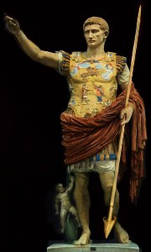
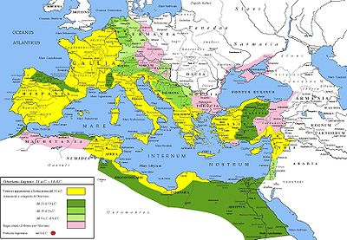
A. Pax Romana
Golden Age of Ancient Rome
~ 200 years – 27-BCE -200 CE
Advancements in many areas

Slide 13
Art | Architecture | Science
Poetry | History/Philosophy | Law

