Slide 1
VI. Imperialism in China

Slide 2
A. Opium War
1. China was militarily weak in the 17th-20th centuries because…
a. The Qing (Manchu) dynasty refused to adopt western technology (b/c of isolated “closed-door” policy)

Slide 3
A. Opium War
2. In late 1700s Britain began selling Opium in large quantities in China
a. Chinese gov’t destroyed one shipment
b. War breaks out b/w Britain and China

Slide 4
A. Opium War
3. Opium War (1839-1842) → British fight Chinese and win easily
a. British force the Chinese to sign the “Treaty of Nanjing”
b. Becomes first of MANY “unequal treaties” China forced to sign

Slide 5
B. What did the Treaty of Nanj(K)ing say?
1. Chinese have to pay reparations for the war
2. Chinese forced to open more ports to British

Slide 6
B. What did the Treaty of Nanj(K)ing say?
3. Europeans carved out SPHERES OF INFLUENCE in China
b. An area of one country under the economic control of another

Slide 7
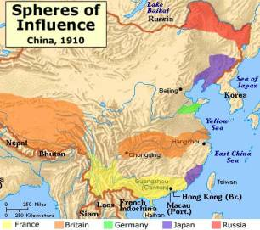

Slide 8
B. What did the Treaty of Nanj(K)ing say?
4. Chinese forced to grant the British “extraterritoriality”
a. “Diplomatic immunity” but for any crimes you wanted

Slide 9
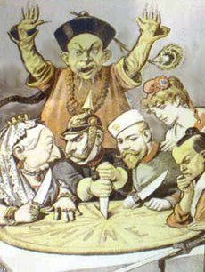
5. British get island of Hong Kong (returned in 1997)

Slide 10
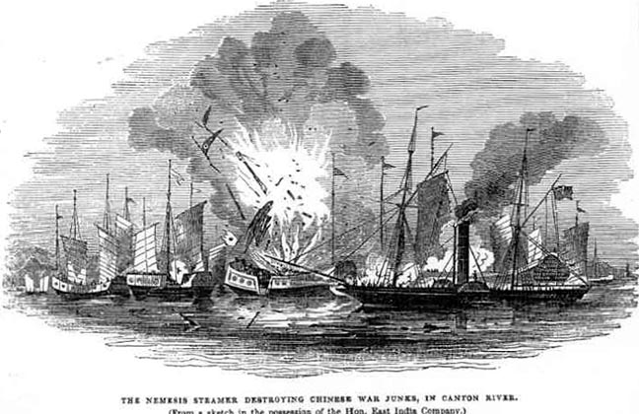
C. Why were Europeans able to imperialize?
Qing dynasty already weak!
** Lacked technology compared to GB, France, etc.!!

Slide 11
D. Chinese Reaction to Imperialism
1. Boxer Rebellion (1900) – group called “Harmonious Fists” assaulted foreigners in China.
2. Foreign nations actually sent their own troops stop rebellion
3. Compare to _____ in ______.

Slide 12
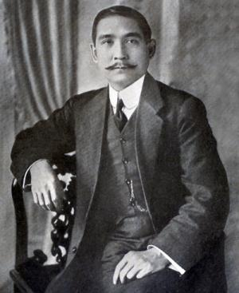
E. End of dynastic rule in China
1. 1911 Qing ends; replaced by Sun-Yat-Sen (Sun Yixian)
2. He believed in the “3 People’s Principles”: Nationalism, Democracy, & People’s Livelihood

Slide 13
F. AFTER THE DYNASTIC CHINA ENDED (1911-1949)
Sun-Yat-Sen was leader of the Nationalist Party, or Kuomintang (KMT) in Chinese
Was not be able to stay in power long
Chaos and conflict dominated next decade

Slide 14
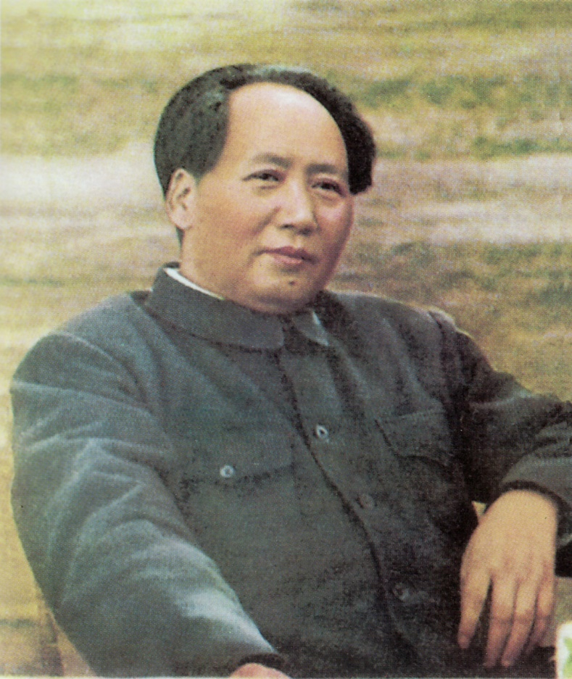
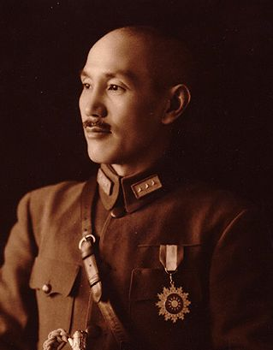
By 1920s a Civil War had broken out b/w Sun’s successor, Chang Kai-Shek and the new Chinese Communist Party led by Mao Zedong
Chang Kai-Shek
Mao Zedong
VS

